Slide 1
RUSTikales Rust for advanced coders

Slide 2
Plan for today

Slide 3
Plan for today
Lifetimes

Slide 4
Lifetimes
Recap: References are pointers to values

Slide 5
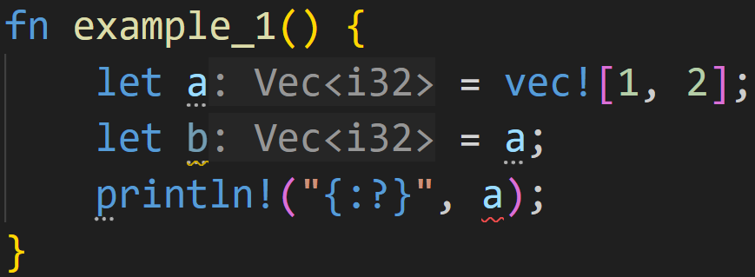
Lifetimes
The problem: Memory safety

Slide 6
Lifetimes
The problem: Memory safety
Compiler moves the value of a into b

Slide 7
Lifetimes
The problem: Memory safety
a
content
length | 2
capacity | 4
heap
0xabc0 | 1
0xabc4 | 2
... | ...

Slide 8
Lifetimes
The problem: Memory safety
a
content
length | 2
capacity | 4
heap
0xabc0 | 1
0xabc4 | 2
... | ...
b
content
length | 2
capacity | 4

Slide 9
Lifetimes
The problem: Memory safety
a
content
length | 2
capacity | 4
heap
0xabc0 | 1
0xabc4 | 2
... | ...
b
content
length | 2
capacity | 4
Ownership violation!
Memory would be freed twice at the end!

Slide 10
Lifetimes
The problem: Memory safety
a
content | ???
length | ???
capacity | ???
heap
0xabc0 | 1
0xabc4 | 2
... | ...
b
content
length | 2
capacity | 4
Solution:
→ Move a into b
→ Invalidate a

Slide 11
Lifetimes
The problem: Memory safety
a
content | ???
length | ???
capacity | ???
Error: a is not initialized, can‘t use it – It was moved

Slide 12
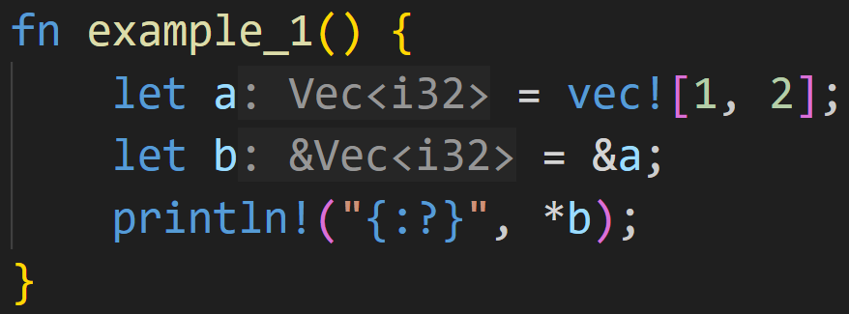
Lifetimes
The solution: References

Slide 13
Lifetimes
The solution: References
b
pointer
a
content
length | 2
capacity | 4
heap
0xabc0 | 1
0xabc4 | 2
... | ...

Slide 14
Lifetimes
The solution: References
b
pointer
a
content
length | 2
capacity | 4
heap
0xabc0 | 1
0xabc4 | 2
... | ...
No ownership violation:
a still owns the memory on the heap
b does not own a, it just points to it

Slide 15
Lifetimes
The solution: References
b
pointer
a
content
length | 2
capacity | 4
heap
0xabc0 | 1
0xabc4 | 2
... | ...
By dereferencing b, we get access to a
→ we print the vector

Slide 16
Lifetimes
The solution: References
b
pointer
a
content
length | 2
capacity | 4
heap
0xabc0 | 1
0xabc4 | 2
... | ...
By dereferencing b, we get access to a
→ we print the vector
→ most of the time, derefs are implicit

Slide 17
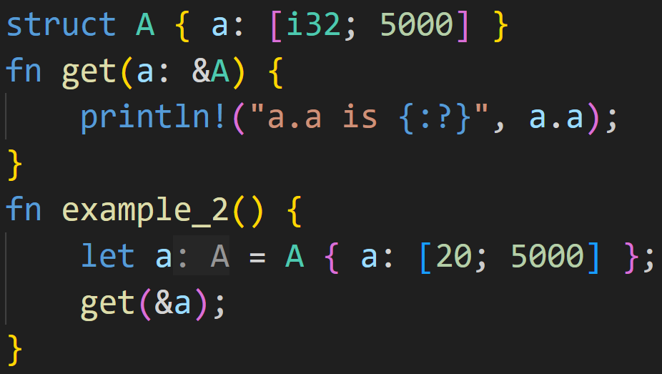
Lifetimes

Slide 18
Lifetimes
big struct!

Slide 19
Lifetimes
By passing a reference, we don‘t need to copy the original value

Slide 20
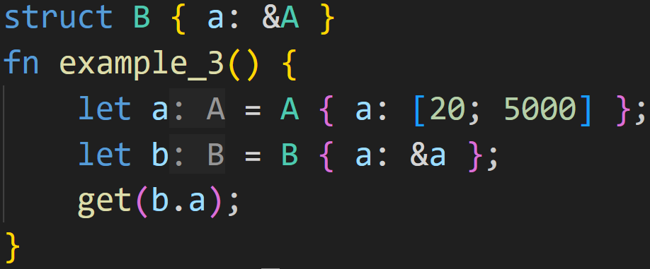
Lifetimes

Slide 21
Lifetimes
Don‘t want to move/copy 20KB of data every time?
Just pass a reference!

Slide 22
Next time
Slices
Smart Pointers

Slide 23

Lifetimes
Oh no

Slide 24
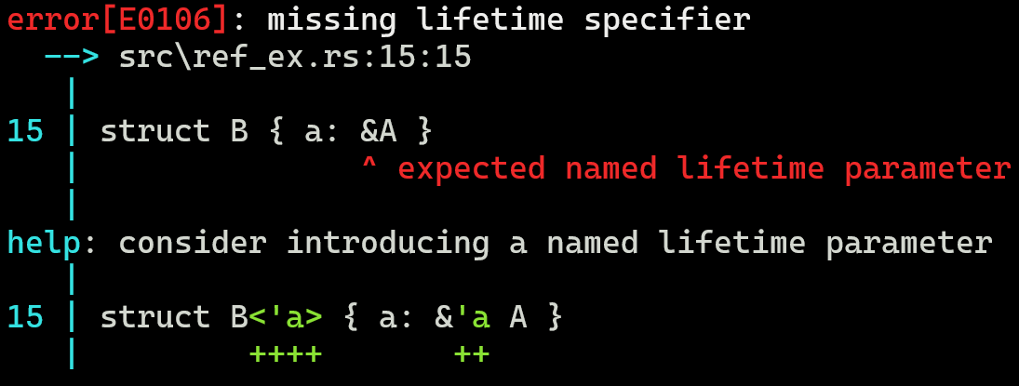
Lifetimes
Well, not quite.

Slide 25
Lifetimes
References in its simplest form are memory addresses
can point to any memory, to the stack, to the heap

Slide 26
Lifetimes
References in its simplest form are memory addresses
can point to any memory, to the stack, to the heap
Pointers are easy to mishandle
dangling pointers
race conditions

Slide 27
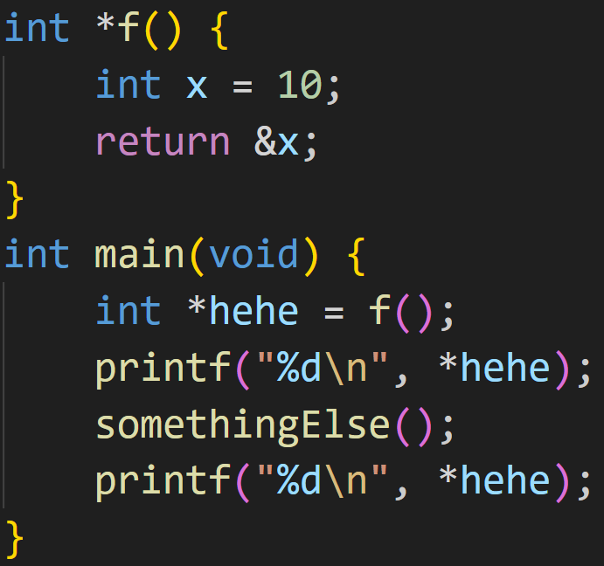
Lifetimes
3/3

Slide 28
Lifetimes
3/3
What does this C code print?

Slide 29
Lifetimes
3/3
What does this C code print?
→ We can‘t know.
→ The first printf() prints 10
→ somethingElse() may overwrite the memory the pointer is pointing to

Slide 30
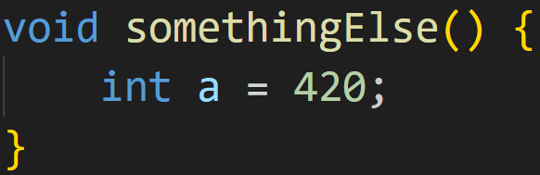
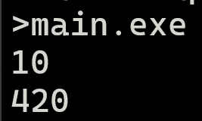
Lifetimes
3/3
What does this C code print?
→ We can‘t know.
→ The first printf() prints 10
→ somethingElse() may overwrite the memory the pointer is pointing to

Slide 31
Lifetimes
References in its simplest form are memory addresses
Pointers are easy to mishandle
More is required to make them memory safe, and fit for Rust‘s goals

Slide 32
Lifetimes
References in its simplest form are memory addresses
Pointers are easy to mishandle
More is required to make them memory safe, and fit for Rust‘s goals
The compiler needs to analyze when and how references are valid
Part One: Borrow Checker
Part Two: Lifetimes

Slide 33
Lifetimes
What is a lifetime?

Slide 34
Lifetimes
What is a lifetime?
Rust docs
https://doc.rust-lang.org/rust-by-example/scope/lifetime.html

Slide 35
Lifetimes
What is a lifetime?
Rust docs
A lifetime is the time between creating and destroying a variable
Different from scopes
Used by the Borrow Checker

Slide 36
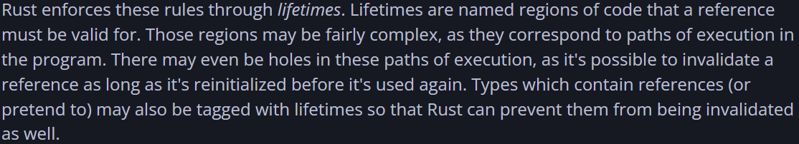
Lifetimes
What is a lifetime?
Rust docs
Rustonomicon
https://doc.rust-lang.org/nomicon/lifetimes.html

Slide 37
Lifetimes
What is a lifetime?
Rust docs
Rustonomicon
Lifetimes enforce Borrow Checker rules
Named regions of code that a reference must be valid for
Tags for references

Slide 38
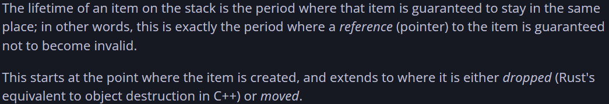
Lifetimes
What is a lifetime?
Rust docs
Rustonomicon
„Effective Rust“
https://www.lurklurk.org/effective-rust/lifetimes.html

Slide 39
Lifetimes
What is a lifetime?
Rust docs
Rustonomicon
„Effective Rust“
A lifetime is the time between creating and destroying an item on the stack
Lifetimes relate to memory locations
Periods in time where a reference is guaranteed to be valid

Slide 40
Lifetimes
What is a lifetime?
Rust docs
A lifetime is the time between creating and destroying a variable
Different from scopes
Used by the Borrow Checker
Rustonomicon
Lifetimes enforce Borrow Checker rules
Named regions of code that a reference must be valid for
Tags for references
„Effective Rust“
A lifetime is the time between creating and destroying an item on the stack
Lifetimes relate to memory locations
Periods in time where a reference is guaranteed to be valid

Slide 41
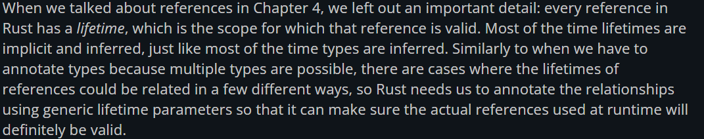
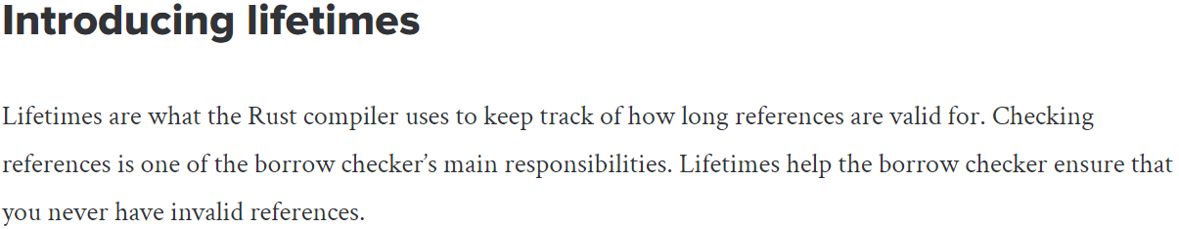
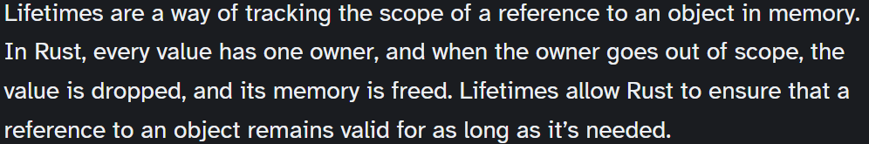
Lifetimes
https://web.mit.edu/rust-lang_v1.25/arch/amd64_ubuntu1404/share/doc/rust/html/book/second-edition/ch10-03-lifetime-syntax.html
https://blog.logrocket.com/understanding-lifetimes-in-rust/
https://earthly.dev/blog/rust-lifetimes-ownership-burrowing/

Slide 42
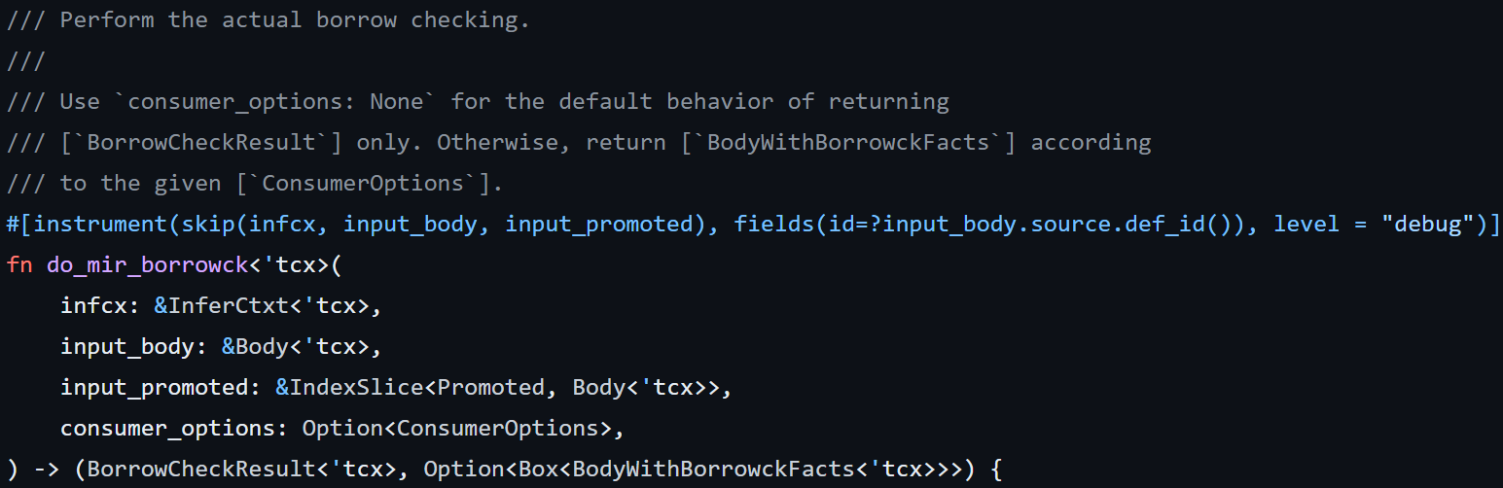
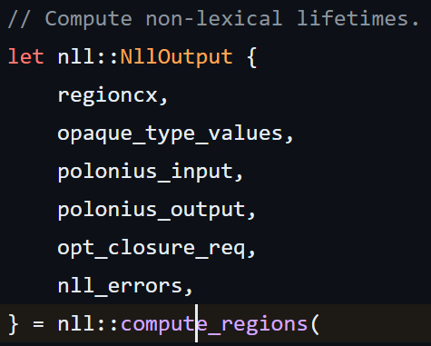
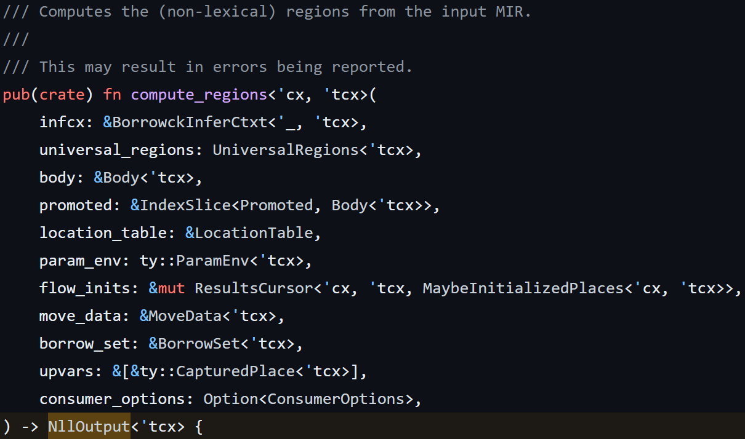
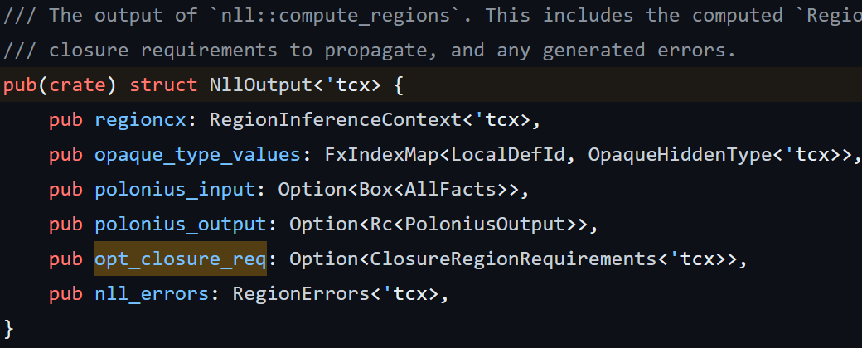
Lifetimes
https://github.com/rust-lang/rust/blob/master/compiler/rustc_borrowck/src/nll.rs
https://github.com/rust-lang/rust/blob/master/compiler/rustc_borrowck/src/lib.rs

Slide 43

Lifetimes
https://github.com/rust-lang/rust/blob/master/compiler/rustc_borrowck/src/nll.rs
https://github.com/rust-lang/rust/blob/master/compiler/rustc_borrowck/src/lib.rs

Slide 44
Lifetimes
Lifetimes are a construct of the compiler
Technically everything is a construct of the compiler

Slide 45
Lifetimes
Lifetimes are a construct of the compiler
Technically everything is a construct of the compiler
Lifetimes allow the compiler to analyze and optimize the final code
Lifetimes don‘t get into the final executable
Memory Safety guarantees

Slide 46
Lifetimes
A lifetime describes two things

Slide 47
Lifetimes
A lifetime describes two things
A region of code where the reference must be valid
A region of memory where the reference may point into

Slide 48
Lifetimes
A lifetime describes two things
A region of code where the reference must be valid
A region of memory where the reference may point into
Many sources only explain lifetimes as liveness (code), but aliasing (memory) is also important
Alias: „variables and pointers alias if they refer to overlapping regions of memory.”

Slide 49
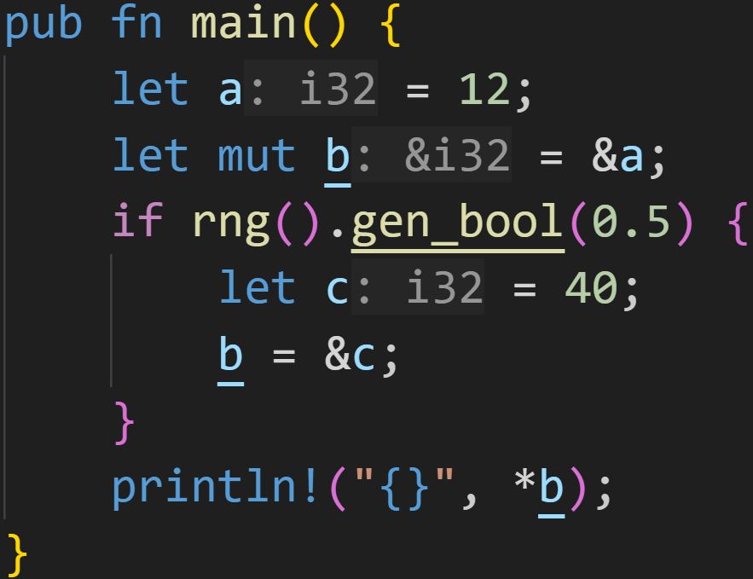
Lifetimes

Slide 50
Lifetimes
region of code where b must be valid

Slide 51
Lifetimes
region of code where b must be valid
ref | value
b
var | value
a | 12
c | 40

Slide 52
Lifetimes
region of code where b must be valid
ref | value
b
var | value
a | 12
c | 40
Depending on RNG, b may point to either a or c
→ When we *b, both memory locations must be alive

Slide 53
Lifetimes
ref | value
b
var | value
a | 12
c | 40
c is alive here and then dropped

Slide 54
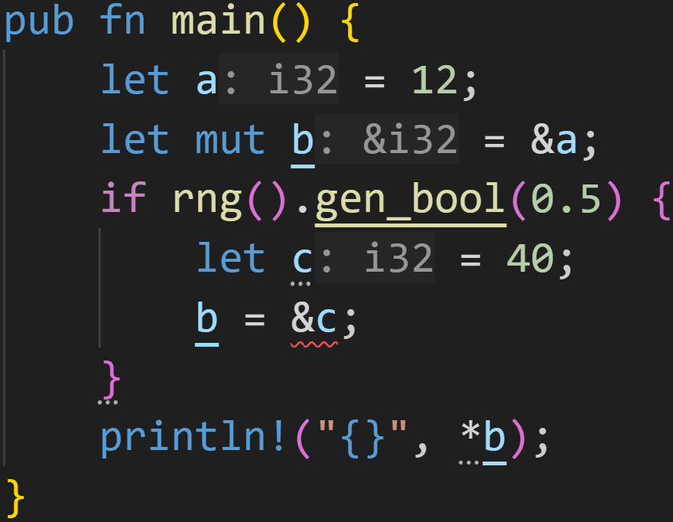
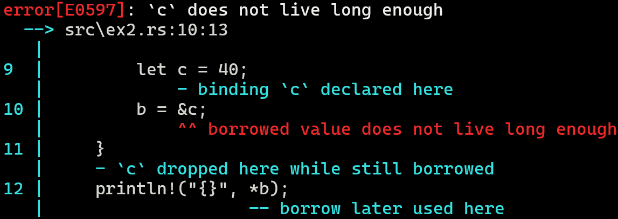
Lifetimes

Slide 55
Lifetimes
A lifetime describes two things
A region of code where the reference must be valid
A region of memory where the original value must live in
The regions of code don‘t have to be contiguous

Slide 56
Lifetimes
A lifetime describes two things
A region of code where the reference must be valid
A region of memory where the original value must live in
The regions of code don‘t have to be contiguous
References must only be valid between uses

Slide 57
Lifetimes
A lifetime describes two things
A region of code where the reference must be valid
A region of memory where the original value must live in
The regions of code don‘t have to be contiguous
References must only be valid between uses
Non-Lexical Lifetimes
The compiler is very good at figuring out the shortest required lifetimes for references

Slide 58
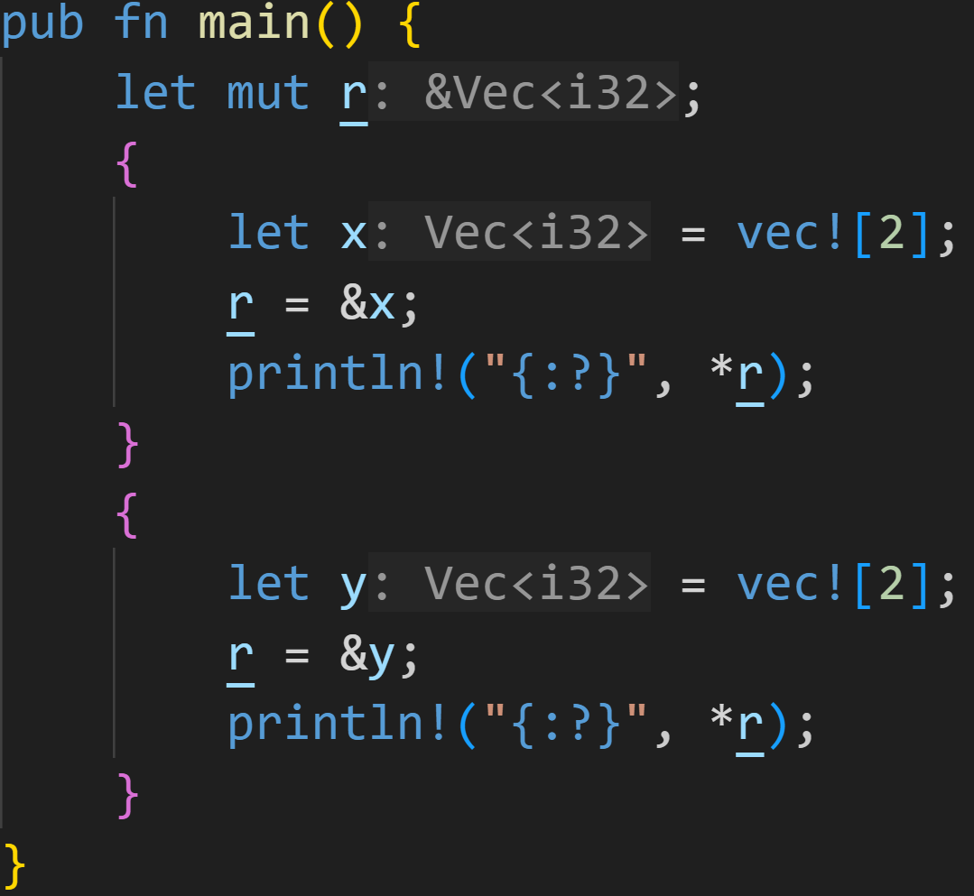
Lifetimes

Slide 59
Lifetimes
region of code where r must be valid
region of code where r must be valid

Slide 60
Lifetimes
region of code where r must be valid
We don‘t care about this section
region of code where r must be valid

Slide 61
Lifetimes
Lifetimes get complicated when you cross the function border

Slide 62
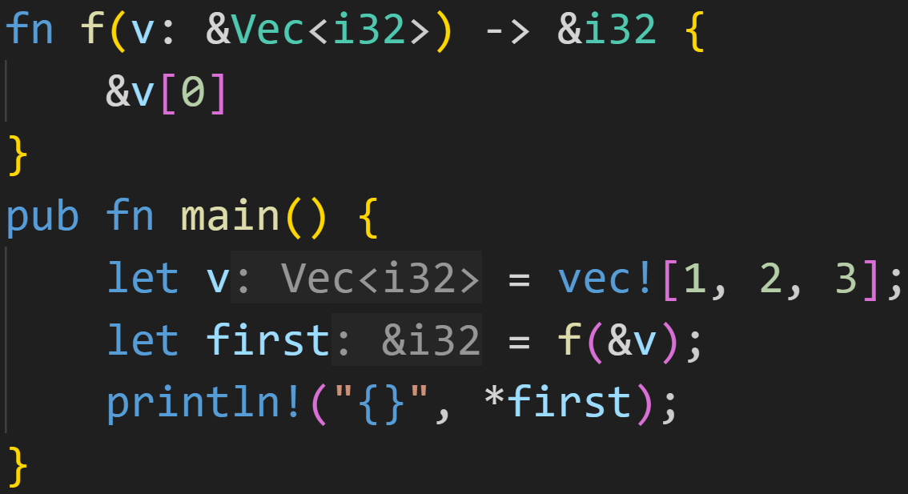
Lifetimes
Lifetimes get complicated when you cross the function border

Slide 63
Lifetimes
Lifetimes get complicated when you cross the function border
How long is this reference alive? :^)

Slide 64
Lifetimes
Lifetimes get complicated when you cross the function border
Lifetime elision, rule 2:
If there is exactly one input lifetime parameter, that lifetime is assigned to all output lifetime parameters

Slide 65
Lifetimes
Lifetimes get complicated when you cross the function border
points to v[0], the compiler didn‘t complain!
first is valid as long as v is alive.

Slide 66
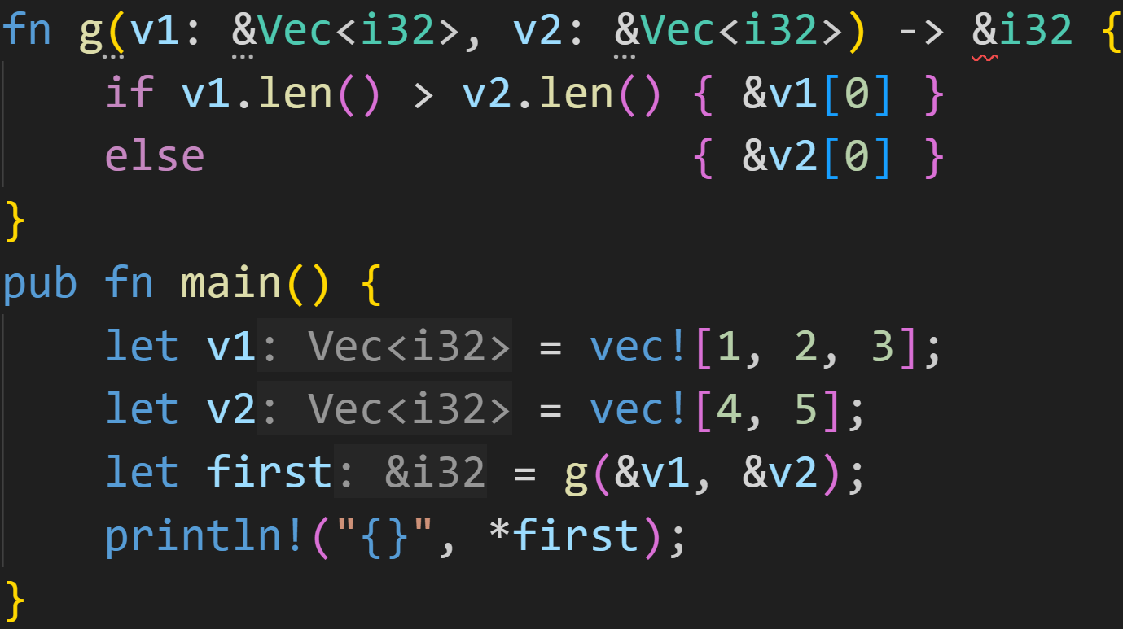
Lifetimes
Lifetimes get complicated when you cross the function border

Slide 67
Lifetimes
Lifetimes get complicated when you cross the function border
Swiggly lines of doom!

Slide 68
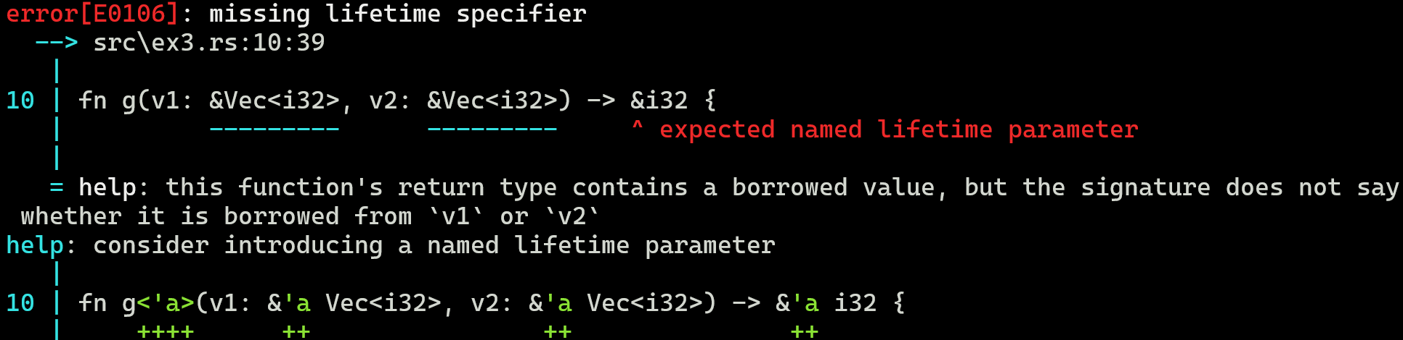
Lifetimes
Lifetimes get complicated when you cross the function border

Slide 69
Lifetimes
Lifetimes get complicated when you cross the function border
What‘s the problem?

Slide 70
Lifetimes
Lifetimes get complicated when you cross the function border
What‘s the problem?
According to the code model, both vectors are borrowed for some amount of time

Slide 71
Lifetimes
Lifetimes get complicated when you cross the function border
What‘s the problem?
According to the code model, both vectors are borrowed for some amount of time
According to the memory model, both vectors are somewhere in memory

Slide 72
Lifetimes
Lifetimes get complicated when you cross the function border
What‘s the problem?
According to the code model, both vectors are borrowed for some amount of time
According to the memory model, both vectors are somewhere in memory
The compiler knows* that the return value is from those vectors

Slide 73
Lifetimes
Lifetimes get complicated when you cross the function border
What‘s the problem?
According to the code model, both vectors are borrowed for some amount of time
According to the memory model, both vectors are somewhere in memory
The compiler knows* that the return value is from those vectors
It just doesn‘t know which vector it is from

Slide 74
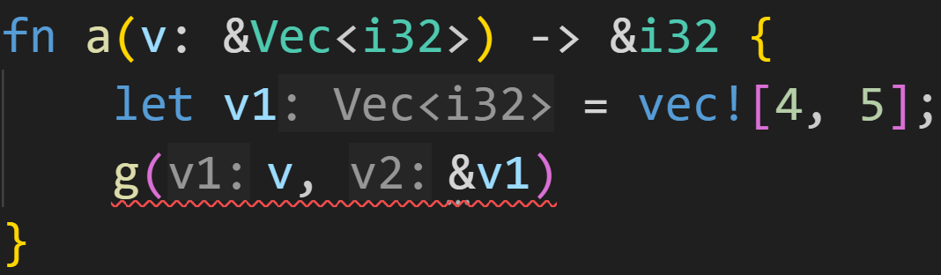
Lifetimes
Lifetimes get complicated when you cross the function border
What‘s the problem?
According to the code model, both vectors are borrowed for some amount of time
According to the memory model, both vectors are somewhere in memory
The compiler knows* that the return value is from those vectors
It just doesn‘t know which vector it is from
Randomly picking a lifetime doesn‘t work, because the lifetimes may be different

Slide 75
Lifetimes
Lifetimes get complicated when you cross the function border
What‘s the problem?
According to the code model, both vectors are borrowed for some amount of time
According to the memory model, both vectors are somewhere in memory
The compiler knows* that the return value is from those vectors
It just doesn‘t know which vector it is from
Randomly picking a lifetime doesn‘t work, because the lifetimes may be different
g could return a reference to elements of v1, which is dropped here

Slide 76
Lifetimes
Lifetimes get complicated when you cross the function border
What‘s the problem?
According to the code model, both vectors are borrowed for some amount of time
According to the memory model, both vectors are somewhere in memory
The compiler knows* that the return value is from those vectors
It just doesn‘t know which vector it is from
Randomly picking a lifetime doesn‘t work, because the lifetimes may be different
We have to provide more information about the lifetimes

Slide 77
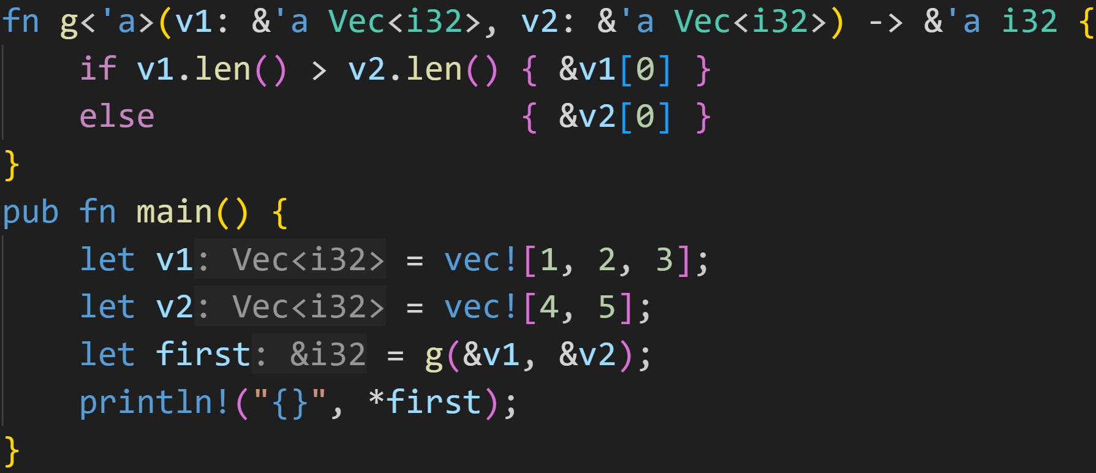
Lifetimes

Slide 78
Lifetimes
named lifetime parameter

Slide 79
Lifetimes
This tells the compiler:
There exists a region of memory ‘a such that:
The original v1 is in that region
The original v2 is in that region
The *return value is in that region
Union of all three regions

Slide 80
Lifetimes
This tells the compiler:
There exists a region of memory ‘a such that:
The original v1 is in that region
The original v2 is in that region
The *return value is in that region
Union of all three regions
[1 – 2 – 3]
‘v1
[4 – 5]
‘v2

Slide 81
Lifetimes
This tells the compiler:
There exists a region of memory ‘a such that:
The original v1 is in that region
The original v2 is in that region
The *return value is in that region
Union of all three regions
‘a
[1 – 2 – 3]
‘v1
[4 – 5]
‘v2

Slide 82
Lifetimes
This tells the compiler:
There exists a region of memory ‘a such that:
The original v1 is in that region
The original v2 is in that region
The *return value is in that region
Union of all three regions
There exists a region of code ‘a such that:
The reference v1 is live in that region
The reference v2 is live in that region
The return value is live in that region
Intersection of all three regions

Slide 83
Lifetimes
The intersection of all three lifetimes is this block

Slide 84
Lifetimes
2/3
Why, if we only borrow in this line?
Shouldn‘t the region only be this line?

Slide 85
Lifetimes
2/3
Why, if we only borrow in this line?
Shouldn‘t the region only be this line?
first is a reference into those vectors, so by proxy we also extended the borrow of v1 and v2 → Aliasing

Slide 86
Lifetimes
2/3
Why, if we only borrow in this line?
Shouldn‘t the region only be this line?
Mutably borrowing either v1 or v2 in this block would throw a compiler error

Slide 87
Lifetimes
This tells the compiler:
There exists a region of memory ‘a such that:
The original v1 is in that region
The original v2 is in that region
The *return value is in that region
Union of all three regions
There exists a region of code ‘a such that:
The reference v1 is live in that region
The reference v2 is live in that region
The return value is live in that region
Intersection of all three regions
It does NOT mean:
v1 and v2 have the same lifetime

Slide 88
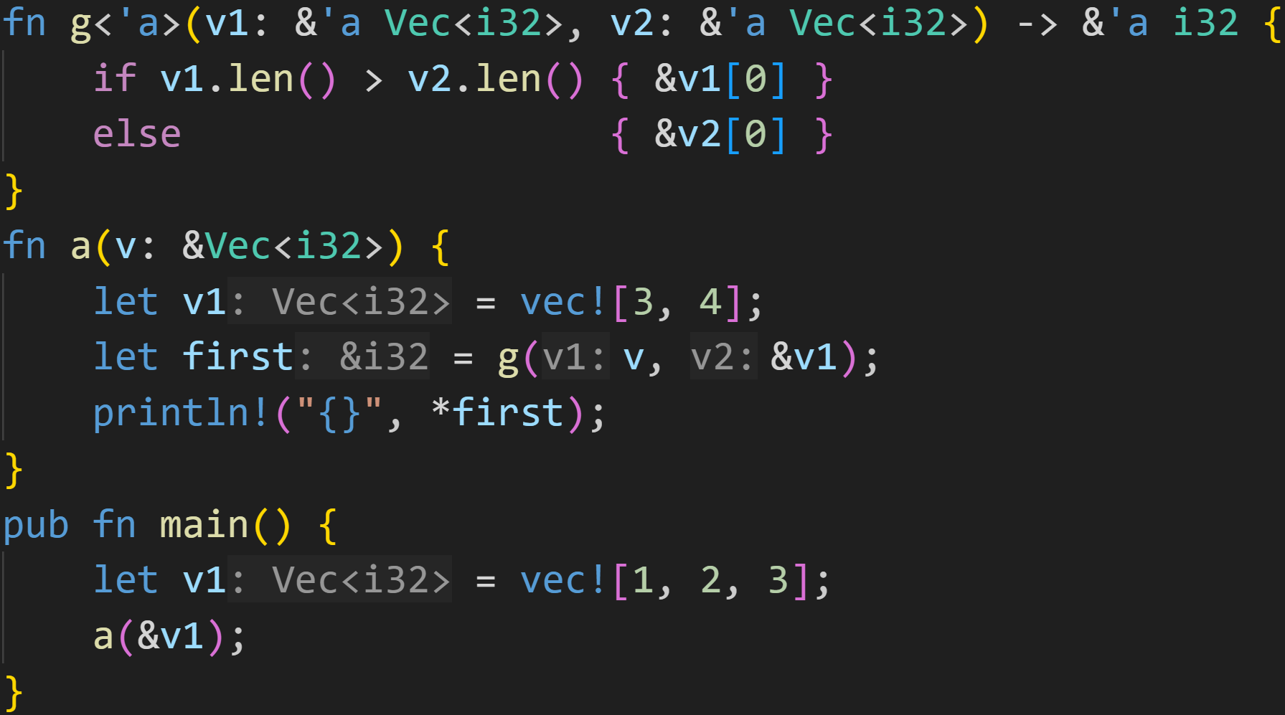
Lifetimes

Slide 89
Lifetimes
It is easy to see that v lives longer than &v1, yet this still works

Slide 90
Lifetimes
The intersection of all three lifetimes is this block

Slide 91
Lifetimes
You can list as many lifetime parameters as you want, as long as you use them

Slide 92
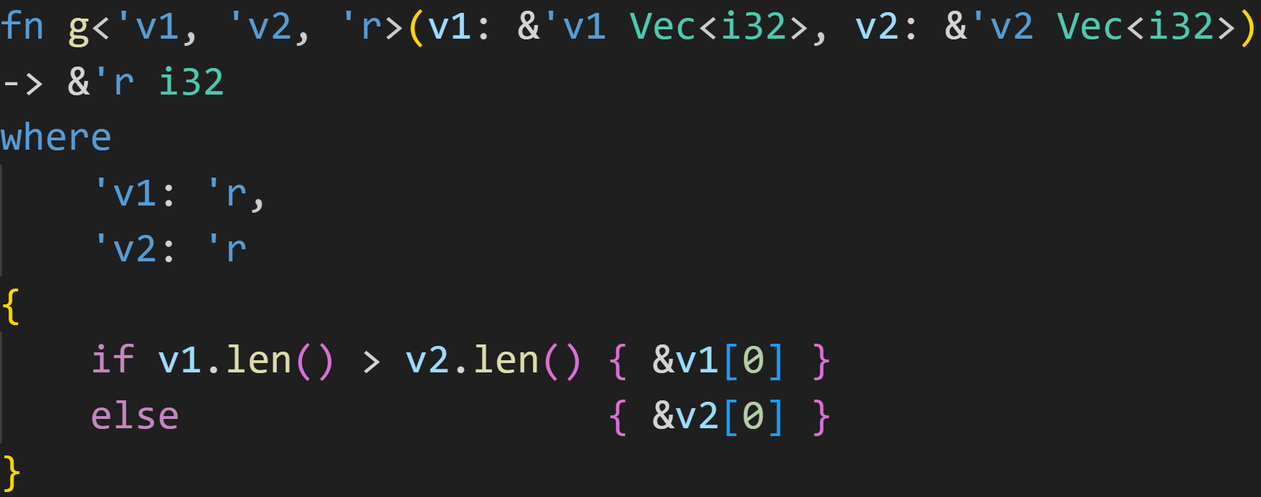
Lifetimes

Slide 93
Lifetimes
v1 and v2 are totally unrelated, there‘s no connection

Slide 94
Lifetimes
However, both ‘v1 and ‘v2 must outlive ‘r

Slide 95
Lifetimes
regions of code → Intersection of all regions → ‘r
regions of memory → Union of all regions → ‘v1&‘v2
→ For a short period, ‘r can borrow data from both vectors
‘r
‘v1
‘v2

Slide 96
Lifetimes
This is also what the compiler does in the background when we only specify ‘a!
Subtyping and Variance

Slide 97
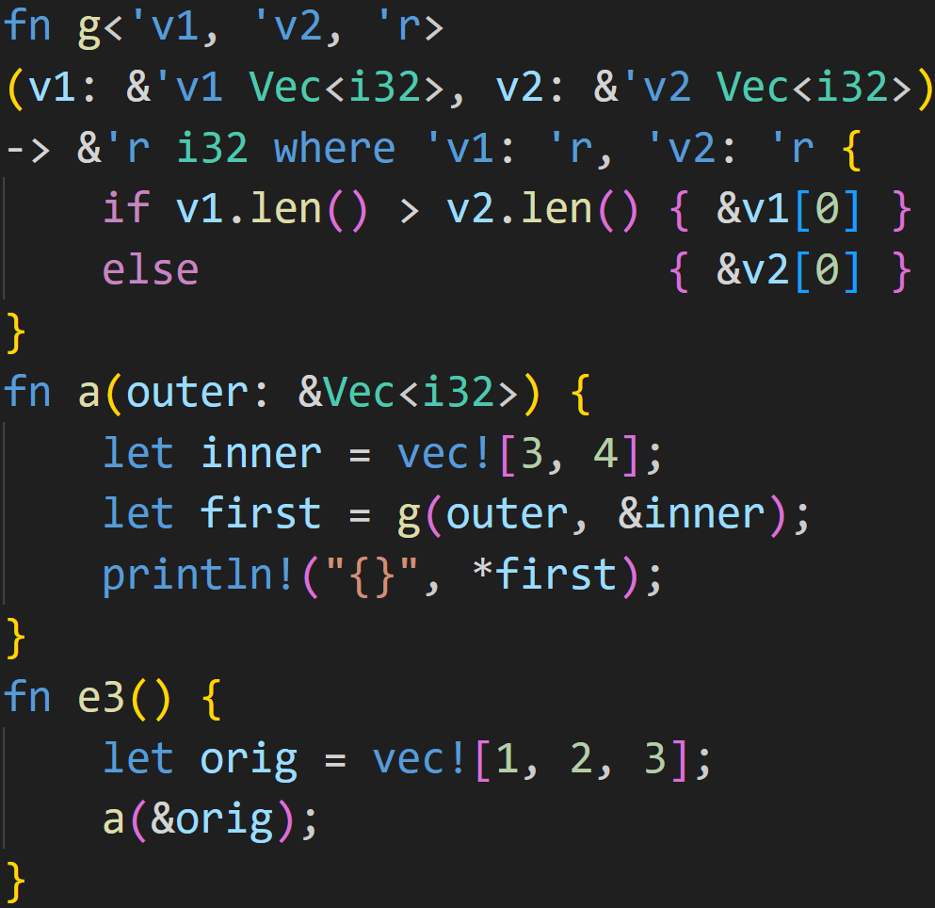
Lifetimes
Stackframe
function | variable | value | refers to

Slide 98
Lifetimes
Stackframe
function | variable | value | refers to
e3 | orig | [1,2,3] | ---

Slide 99
Lifetimes
Stackframe
function | variable | value | refers to
e3 | orig | [1,2,3] | ---
start of ‘v1

Slide 100
Lifetimes
Stackframe
function | variable | value | refers to
e3 | orig | [1,2,3] | ---
a | outer | ‘v1 | orig
 | inner
 | first

Slide 101
Lifetimes
Stackframe
function | variable | value | refers to
e3 | orig | [1,2,3] | ---
a | outer | ‘v1 | orig
 | inner | [3,4] | ---
 | first

Slide 102
Lifetimes
Stackframe
function | variable | value | refers to
e3 | orig | [1,2,3] | ---
a | outer | ‘v1 | orig
 | inner | [3,4] | ---
 | first
start of ‘v2

Slide 103
Lifetimes
Stackframe
function | variable | value | refers to
e3 | orig | [1,2,3] | ---
a | outer | ‘v1 | orig
 | inner | [3,4] | ---
 | first
g | v1 | ‘v1 | orig
 | v2 | ‘v2 | inner
 | result

Slide 104
Lifetimes
Stackframe
function | variable | value | refers to
e3 | orig | [1,2,3] | ---
a | outer | ‘v1 | orig
 | inner | [3,4] | ---
 | first
g | v1 | ‘v1 | orig
 | v2 | ‘v2 | inner
 | result
‘r is the smallest lifetime such that ‘v1 and ‘v2 are both also alive inside it

Slide 105
Lifetimes
Stackframe
function | variable | value | refers to
e3 | orig | [1,2,3] | ---
a | outer | ‘v1 | orig
 | inner | [3,4] | ---
 | first
g | v1 | ‘v1 | orig
 | v2 | ‘v2 | inner
 | result
‘r is the smallest lifetime such that ‘v1 and ‘v2 are both also alive inside it
→ orig lives in e3 → ‘v1 live in e3

Slide 106
Lifetimes
Stackframe
function | variable | value | refers to
e3 | orig | [1,2,3] | ---
a | outer | ‘v1 | orig
 | inner | [3,4] | ---
 | first
g | v1 | ‘v1 | orig
 | v2 | ‘v2 | inner
 | result
‘r is the smallest lifetime such that ‘v1 and ‘v2 are both also alive inside it
→ orig lives in e3 → ‘v1 live in e3
→ inner lives in a → ‘v2 live in a

Slide 107
Lifetimes
Stackframe
function | variable | value | refers to
e3 | orig | [1,2,3] | ---
a | outer | ‘v1 | orig
 | inner | [3,4] | ---
 | first
g | v1 | ‘v1 | orig
 | v2 | ‘v2 | inner
 | result
‘r is the smallest lifetime such that ‘v1 and ‘v2 are both also alive inside it
→ orig lives in e3 → ‘v1 live in e3
→ inner lives in a → ‘v2 live in a
→ inner does not live in e3 → ‘v2 stuck in a

Slide 108
Lifetimes
Stackframe
function | variable | value | refers to
e3 | orig | [1,2,3] | ---
a | outer | ‘v1 | orig
 | inner | [3,4] | ---
 | first
g | v1 | ‘v1 | orig
 | v2 | ‘v2 | inner
 | result | ‘r | both
‘r is the smallest lifetime such that ‘v1 and ‘v2 are both also alive inside it
→ orig lives in e3 → ‘v1 live in e3
→ inner lives in a → ‘v2 live in a
→ inner does not live in e3 → ‘v2 stuck in a
→ return reference ‘r alive in a
→ not allowed to escape to e3

Slide 109
Lifetimes
Stackframe
function | variable | value | refers to
e3 | orig | [1,2,3] | ---
a | outer | ‘v1 | orig
 | inner | [3,4] | ---
 | first | ‘r | both

Slide 110
Lifetimes
Stackframe
function | variable | value | refers to
e3 | orig | [1,2,3] | ---
a | outer | ‘v1 | orig
 | inner | [3,4] | ---
 | first | ‘r | both
This is ‘r, first can be from both inner and orig here

Slide 111
Lifetimes
Stackframe
function | variable | value | refers to
e3 | orig | [1,2,3] | ---
a | outer | ‘v1 | orig
 | inner | [3,4] | ---
 | first | ‘r | both
Use is valid, both original values are alive

Slide 112
Lifetimes
Stackframe
function | variable | value | refers to
e3 | orig | [1,2,3] | ---
a | outer | ‘v1 | orig
 | inner | [3,4] | ---
 | first | ‘r | both
end of ‘v2 and ‘r

Slide 113
Lifetimes
Stackframe
function | variable | value | refers to
e3 | orig | [1,2,3] | ---

Slide 114
Lifetimes
Stackframe
function | variable | value | refers to
end of ‘v1

Slide 115
Lifetimes
Structs can also have references as fields
For that, you have to specify lifetime parameters

Slide 116
Lifetimes
Structs can also have references as fields
For that, you have to specify lifetime parameters
Structs are way more flexible than functions, you can use them literally everywhere → Inferring lifetimes is way harder :^)

Slide 117
Lifetimes
Structs can also have references as fields
Many situations arise when you need that, and many where you want that

Slide 118
Lifetimes
Structs can also have references as fields
Many situations arise when you need that, and many where you want that
Less memory usage
Less computation (cloning is expensive)

Slide 119
Lifetimes
Structs can also have references as fields
Many situations arise when you need that, and many where you want that
At the same time, in many situations you do not want that

Slide 120
Lifetimes
Structs can also have references as fields
Many situations arise when you need that, and many where you want that
At the same time, in many situations you do not want that
Explicit lifetimes makes your code harder to use and maintain
All lifetimes have to line up, in every case, or it falls apart quickly

Slide 121
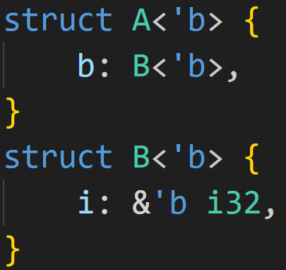
Lifetimes
Structs can also have references as fields
Many situations arise when you need that, and many where you want that
At the same time, in many situations you do not want that
Explicit lifetimes makes your code harder to use and maintain
Lifetime infection will make your code unreadable

Slide 122
Lifetimes
Structs can also have references as fields
Many situations arise when you need that, and many where you want that
At the same time, in many situations you do not want that
Explicit lifetimes makes your code harder to use and maintain
Lifetime infection will make your code unreadable
A itself doesn‘t need a lifetime parameter!
But you have to propagate it, it‘s now also A‘s business

Slide 123
Lifetimes
Structs can also have references as fields
Many situations arise when you need that, and many where you want that
At the same time, in many situations you do not want that
If things get out of hand:
Read about Ownership again, do they need references? Isn‘t it better to own the data?
Use Smart Pointers

Slide 124
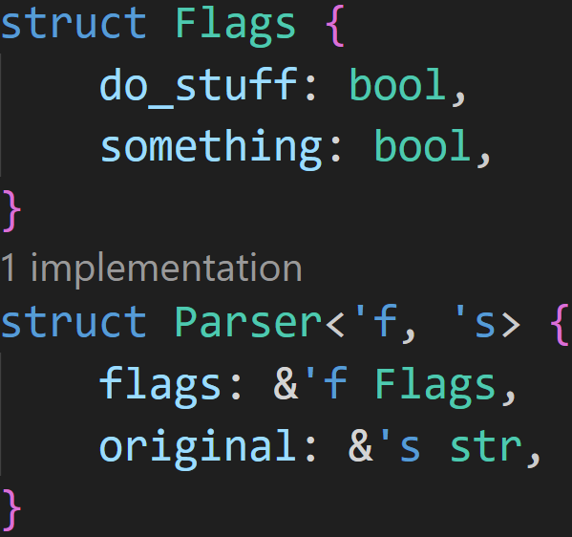
Lifetimes

Slide 125
Lifetimes
Two lifetime parameters

Slide 126
Lifetimes
Two lifetime parameters
The original Flags struct has to outlive the Parser

Slide 127
Lifetimes
Two lifetime parameters
The original Flags struct has to outlive the Parser
The original source text has to outlive the Parser

Slide 128
Lifetimes
Two lifetime parameters
The original Flags struct has to outlive the Parser
The original source text has to outlive the Parser
The original Flags struct is unrelated to the original source text

Slide 129
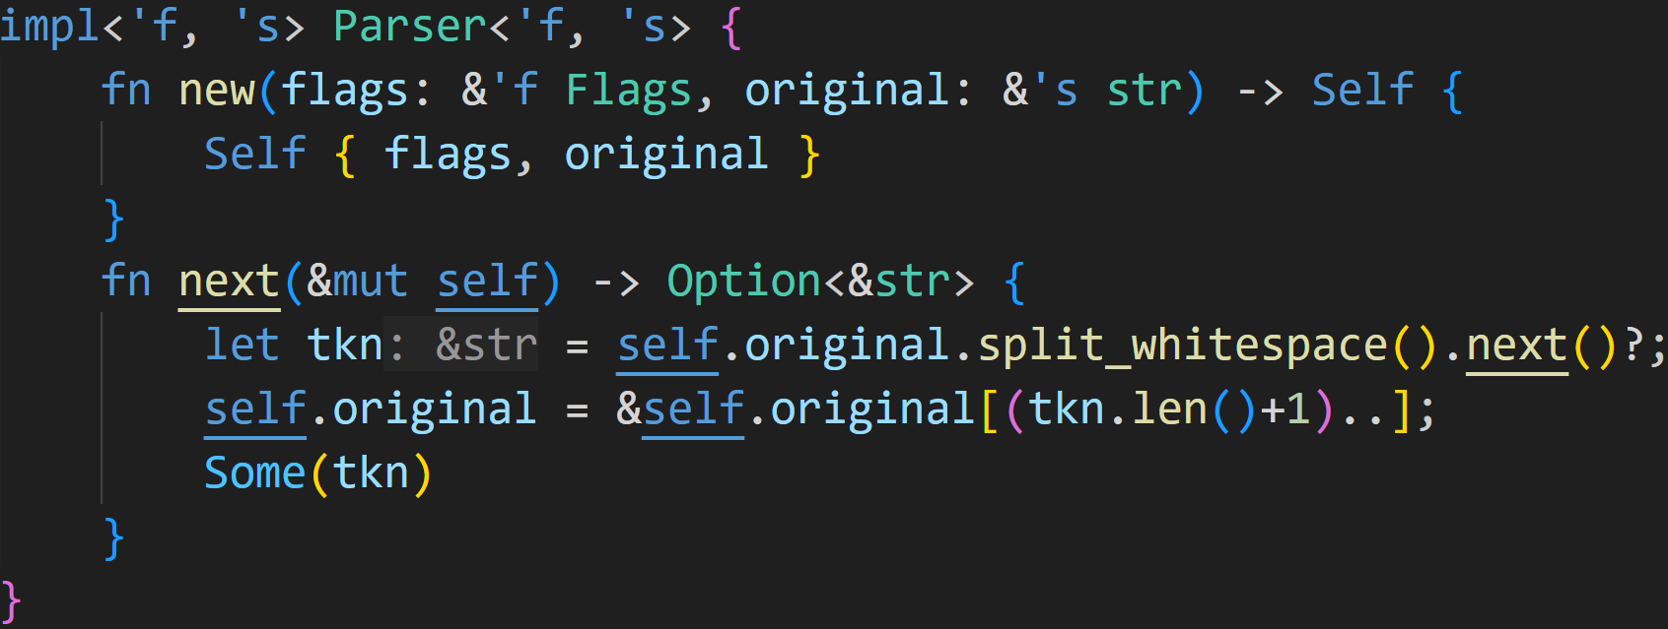
Lifetimes

Slide 130
Lifetimes
Declares lifetime parameters for the whole struct

Slide 131
Lifetimes
Declares lifetime parameters for the whole struct
Can be used in all methods and associated functions
→ No need to annotate new() with them again

Slide 132
Lifetimes
Lifetime elision, rule 3: if there are multiple input lifetime parameters, but one of them is &self or &mut self because this is a method, the lifetime of self is assigned to all output lifetime parameters

Slide 133
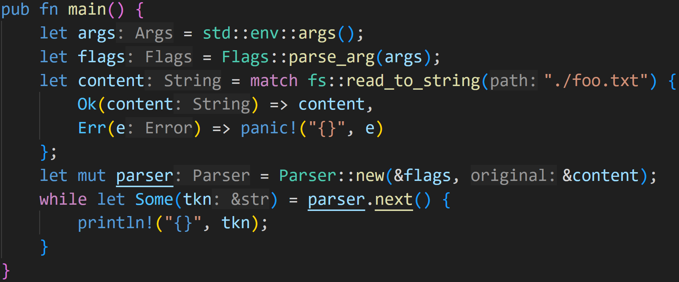
Lifetimes

Slide 134
Lifetimes
flags are alive here

Slide 135
Lifetimes
flags are alive here content is alive here

Slide 136
Lifetimes
flags are alive here content is alive here
parser is alive here

Slide 137
Lifetimes
tkn is a reference into the content
flags are alive here content is alive here
parser is alive here
tkn is alive here

Slide 138
Lifetimes
Borrowed data does not outlive original → Lifetimes valid, Borrow Checker passed!
tkn is a reference into the content
flags are alive here content is alive here
parser is alive here
tkn is alive here

Slide 139
Next time
Slices
Smart Pointers

